Slide 1
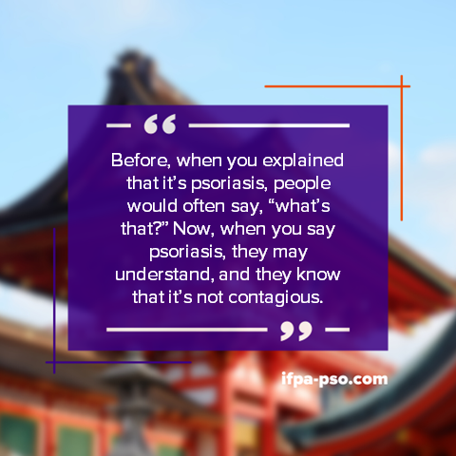
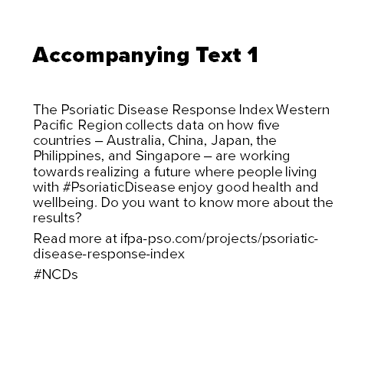
Psoriatic Disease Response Index:
Western Pacific Region
Thank you for joining us in promoting the Psoriatic Disease Response Index – Western Pacific Region.
In this PowerPoint are steps to help you promote the report across all social media platforms.
The report will be launched on July 3, 2023. In this presentation you will find sample tiles with accompanying text. You are welcome to edit these both, according to your needs.

Slide 2
Getting Started
Follow us @psoriasisIFPA (Twitter, Facebook, Instagram, LinkedIn)
Select social media messages for your desired platform
Use our hashtag #psoriaticdisease
Use our campaign images in square format; Export the images as JPG or PNG and upload with corresponding message

Slide 3

Before, when you explained that it’s psoriasis, people would often say, “what’s that?” Now, when you say psoriasis, they may understand, and they know that it’s not contagious.

Slide 4
Accompanying Text 1
The Psoriatic Disease Response Index Western Pacific Region collects data on how five countries – Australia, China, Japan, the Philippines, and Singapore – are working towards realizing a future where people living with #PsoriaticDisease enjoy good health and wellbeing. Do you want to know more about the results?
Read more at ifpa-pso.com/projects/psoriatic-disease-response-index
#NCDs #psoriaticdisease

Slide 5

I didn’t know that psoriasis had symptoms of arthritis. When my pain got worse, I went to see an orthopedist. But he didn’t know so much about arthritis, so my diagnosis was delayed, and my toes were deformed.

Slide 6
Accompanying Text 2
The time between when symptoms first appear and diagnosis of #PsoriaticDisease is far too long. This impacts disease progression, morbidity and long-term health in affected individuals. People deserve faster diagnosis and treatment.
Read more at ifpa-pso.com/projects/psoriatic-disease-response-index
#NCDs #UHC #HealthForAll #psoriaticdisease

Slide 7

Some people are afraid of psoriasis because of how the lesions look. But it’s getting better.

Slide 8
Accompanying Text 2
#DidYouKnow A study on the impact on quality of life in Chinese individuals living with #psoriaticdisease showed that participants were likely to avoid public places, avoid meeting friends and worry about how others react to their visible symptoms. Stop stigma, now! Read more at ifpa-pso.com/projects/psoriatic-disease-response-index
#mentalhealth #NCDs #psoriaticdisease

Slide 9

Unfortunately, a lot of patients won’t visit healthcare professionals immediately because of the stigma associated with psoriasis.

Slide 10
Accompanying Text 3
The spoken word for psoriasis in Japan (“Kansen”) sounds the same as the word for infection. As a result, some people living with #psoriaticdisease feel the need to hide their symptoms with clothing or hairstyles. But #psoriaticdisease is not contagious!
Read more at ifpa-pso.com/projects/psoriatic-disease-response-index
#NCDs #psoriaticdisease

Slide 11

For those living in remote areas it’s a very big help to provide trainings for general practitioners.

Slide 12
Accompanying Text 4
Different healthcare systems have different access to #psoriaticdisease -related training for GPs. Where there is a lack of knowledge, patients can be mis-diagnosed, receive ineffective therapy, remain on an ineffective therapy for too long resulting, and experience a failure to recognize the link between psoriatic disease and comorbidities. Read more at ifpa-pso.com/projects/psoriatic-disease-response-index
#UHC #NCDs #HealthForAll #psoriaticdisease

Slide 13

When guidelines are implemented in clinical practice by care providers, the quality of care increases

Slide 14
Accompanying Text 5
State or regional institutions should develop, adapt and/or promote #psoriaticdisease guidelines. Read more at ifpa-pso.com/projects/psoriatic-disease-response-index
#NCDs #psoriaticdisease

Slide 15
I didn’t know that psoriasis had symptoms of arthritis. When my pain got worse, I went to see an orthopedist. But he didn’t know so much about arthritis, so my diagnosis was delayed, and my toes were deformed.

Slide 16
Accompanying Text 6
#DidYouKnow The time between when symptoms first appear and diagnosis of #psoriaticdisease is far too long. Clinicians find this unacceptable and recognize that early diagnosis and treatment is important to limit patient morbidity. Read more at ifpa-pso.com/projects/psoriatic-disease-response-index
#NCDs #psoriaticdisease

Slide 17

I have to go to the university hospital every three months to obtain my medications. It takes about 40 minutes by car. In addition, biologics are very expensive, so it is not easy to obtain the medicines.

Slide 18
Accompanying Text 6
In Japan, biologics are only prescribed in some clinics with board-certified specialists, which are absent in more rural areas. Therefore, it is more difficult for people with moderate or severe #psoriaticdisease in rural areas to access the right treatment, and they might continue to receive sub-optimal treatment for too long. Read more at ifpa-pso.com/projects/psoriatic-disease-response-index
#UHC #NCDs #HealthForAll #psoriaticdisease

Slide 19

It would be difficult for a patient to voluntarily bring up psychological symptoms if the doctor does not ask.

Slide 20
Accompanying Text 7
#DidYouKnow There is a stigma around seeking psychological support, preventing individuals from receiving adequate #mentalhealth care even when it is available. This is a serious problem which must be addressed by care providers and society at large. Read more at ifpa-pso.com/projects/psoriatic-disease-response-index
#psoriaticdisease #NCDs

