Slide 1


WPD 2021 PSONUVES ACTIVITIES

Slide 2

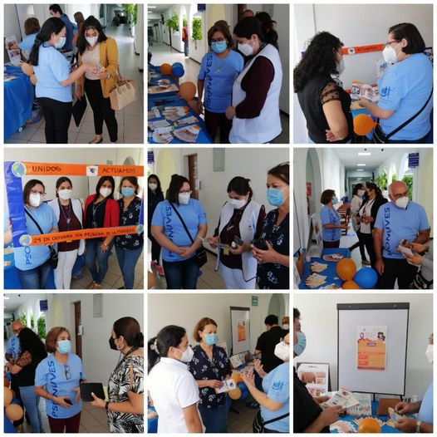
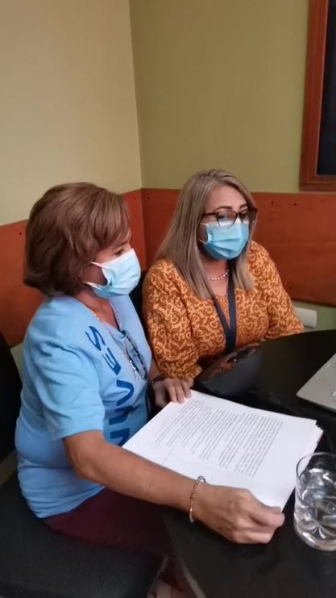
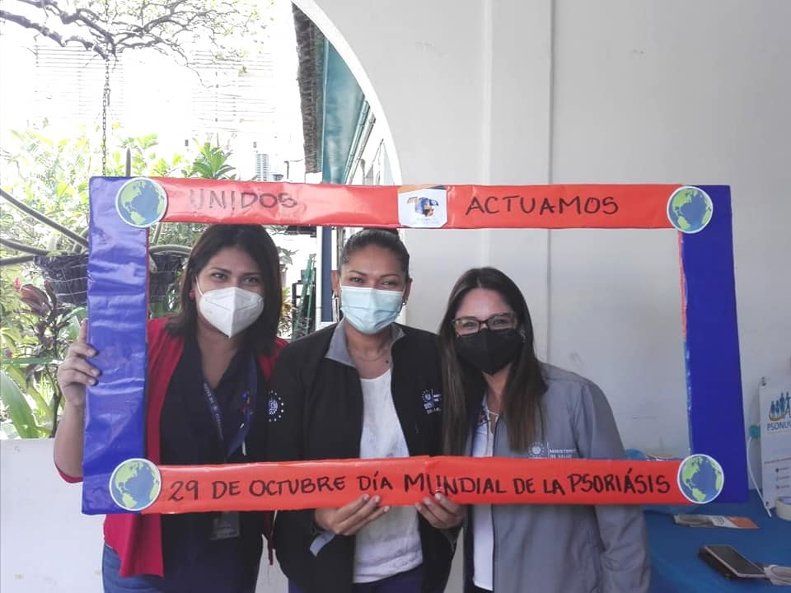
ACTIVITIES WITH SALVADORIAN MINISTRY OF HEALTH
Awarness Campaign Ministry of Health date: Oct.29
Place Ministry of Health from El Salvador
https://fb.watch/8ZbU-GxwyH/

Slide 3
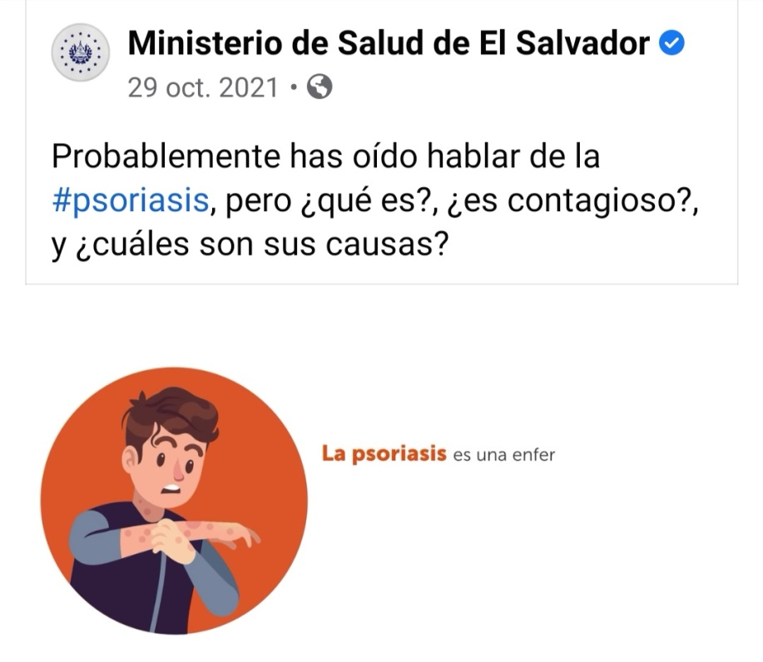
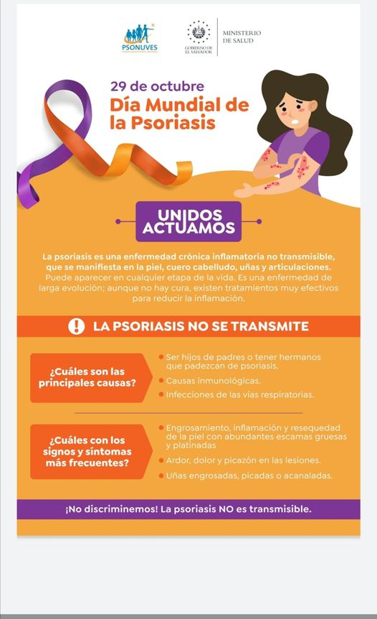

AWARENESS CAMPAIGN SOCIAL MEDIA, SALVADORIAN MINISTRY OF HEALTH
https://fb.watch/av4HAryxzI/ date :29 Oct.2021

Slide 4
ONLINE PUBLICATIONS
https://laedicionsv.com/2021/10/30/unidos-actuamos-mejor/
https://laedicionsv.com/2021/10/15/factores-dieteticos-que-influyen-en-la-psoriasis/
https://laedicionsv.com/2021/10/20/unidos-actuamos-como-sobrellevar-la-psoriasis/

Slide 5
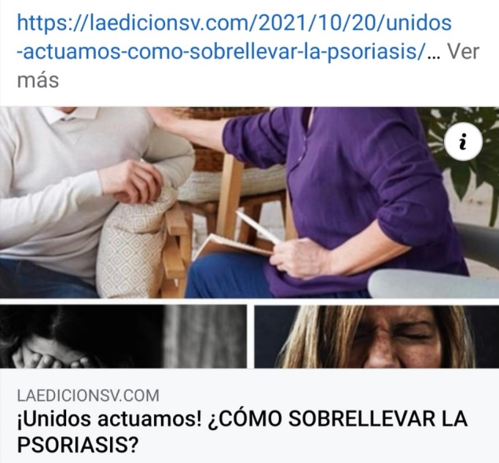
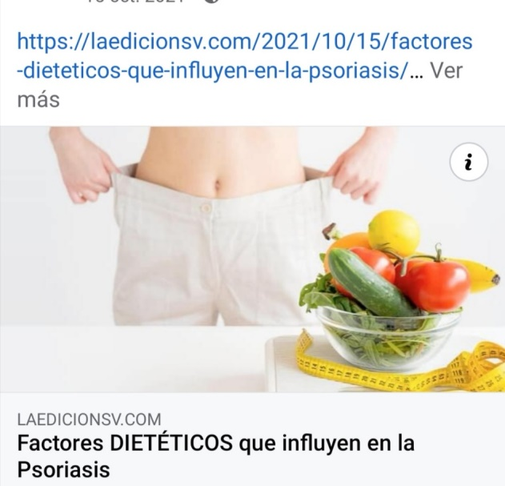
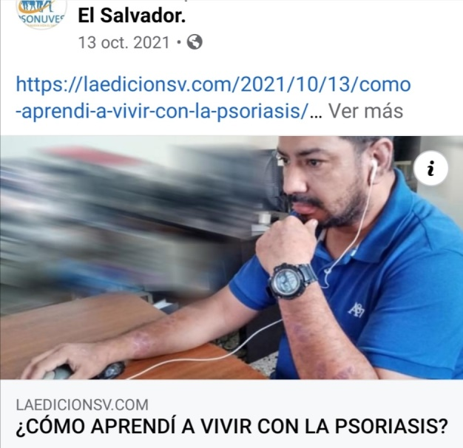
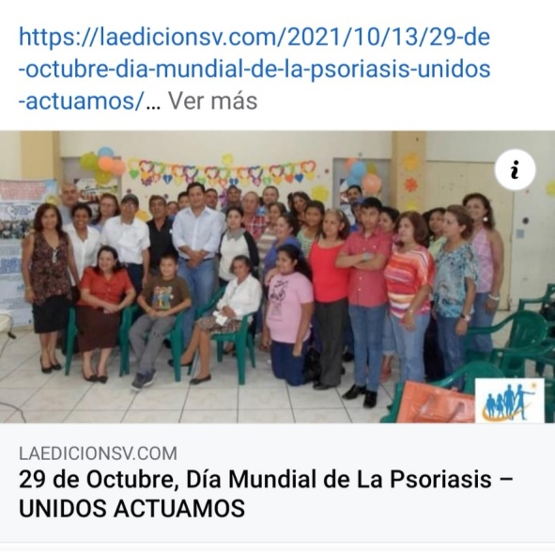
ONLINE NEWSPAPER LA EDICION

Slide 6

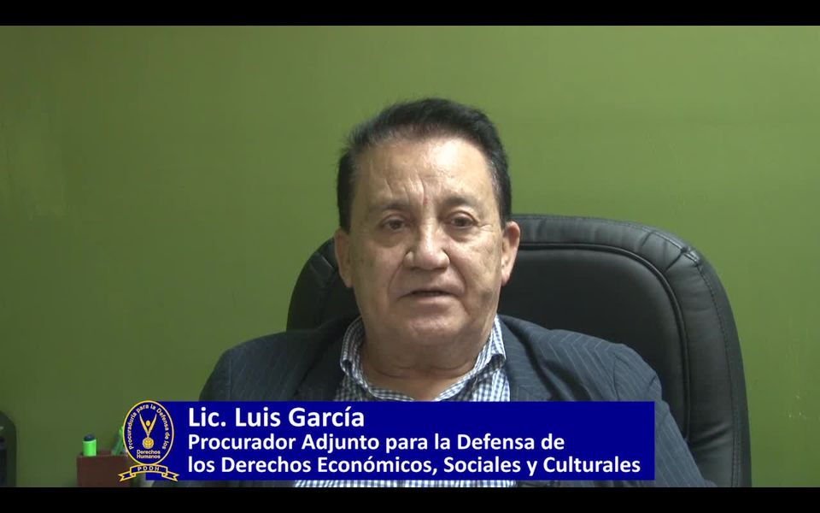
MEDIA CAMPAIGN HUMAN RIGHTS
https://www.facebook.com/100067194183039/posts/208009611448844/?app=fbl
Date 29 OCT.

Slide 7
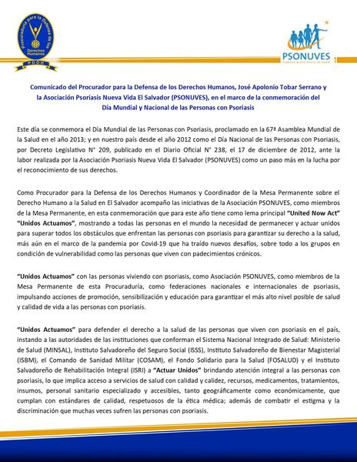
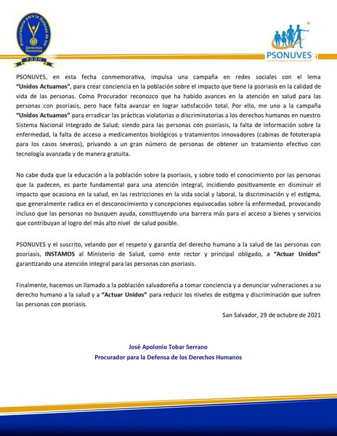
PRESS RELEASE ON SOCIAL MEDIA HUMAN RIGHTS
https://twitter.com/PDDHElSalvador/status/1454125702379458565?s=20
Date :Oct 29

Slide 8
VIDEO CAMPAIGN UNITED NOW ACT
Lic. Rossana Cornejo https://fb.watch/av6v_C82By/
Lic. Vilma Melendez https://fb.watch/av6F3jveWv/
Members PSONUVES Video https://fb.watch/av6H2BJQN0/
May video https://fb.watch/av6IYnDhgu/
https://laedicionsv.com/2021/10/30/unidos-actuamos-mejor/

Slide 9
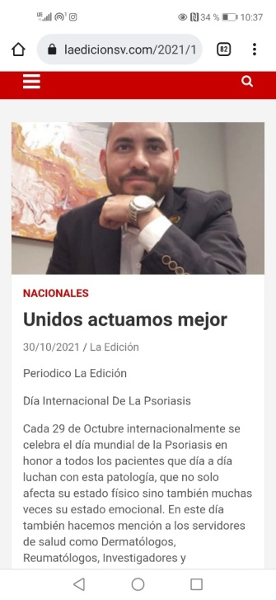
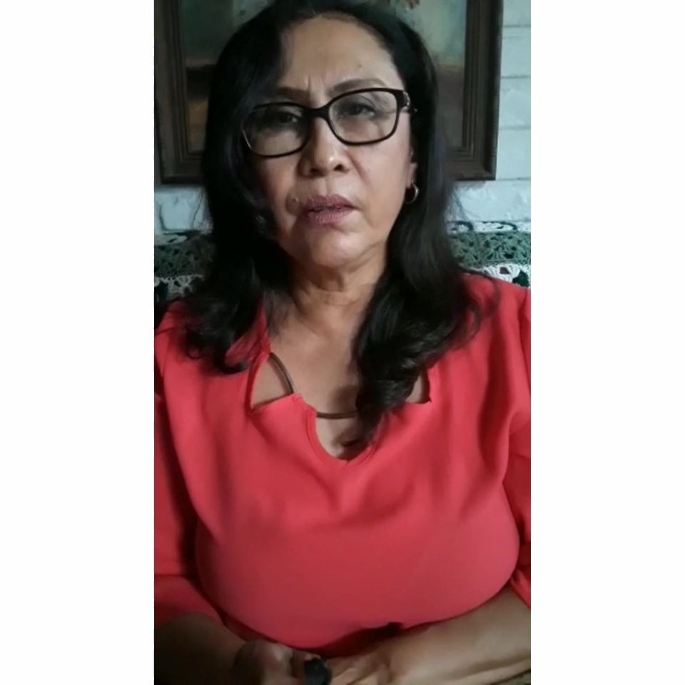
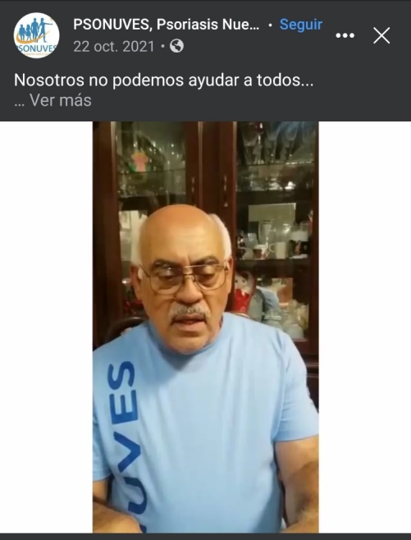
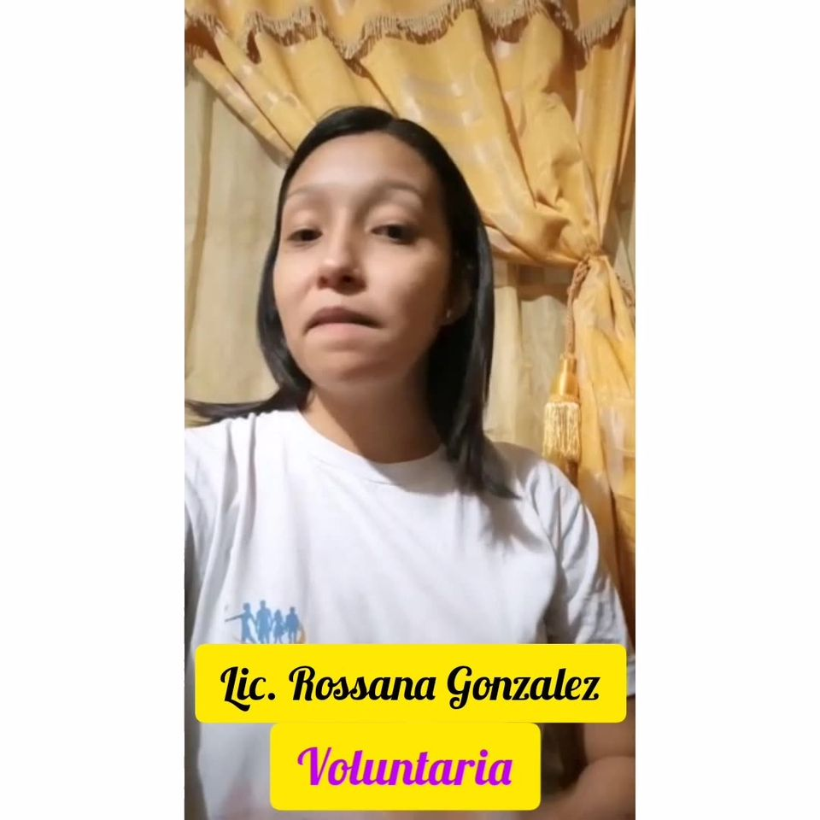
VIDEO CAMPAIGN UNITED WE ACT

Slide 10
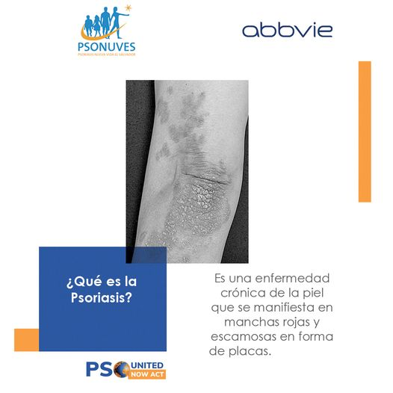
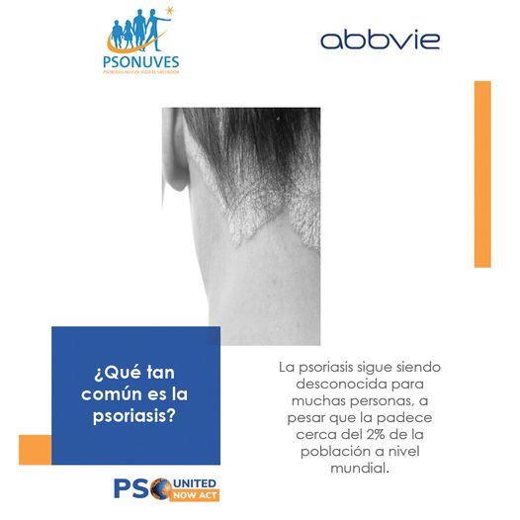

SOCIAL MEDIA CAMPAING

Slide 11
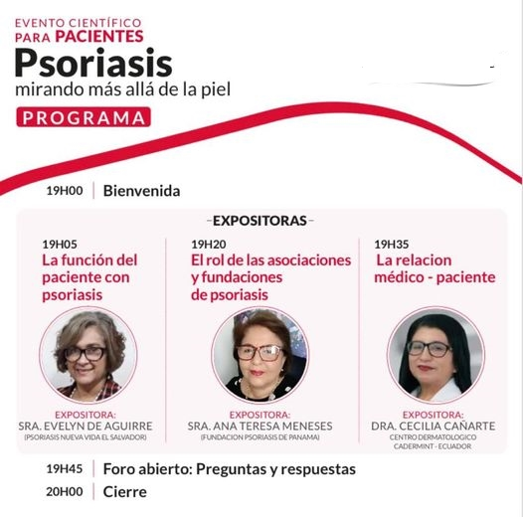
INTERNATIONAL TALK
Scientific event for patients Place: Ecuador date: 28 Oct

Slide 12
THANK YOU

