Slide 1
Organization activities in 2021
www.skinallergic.com
oppsor@yandex.ru

Slide 2

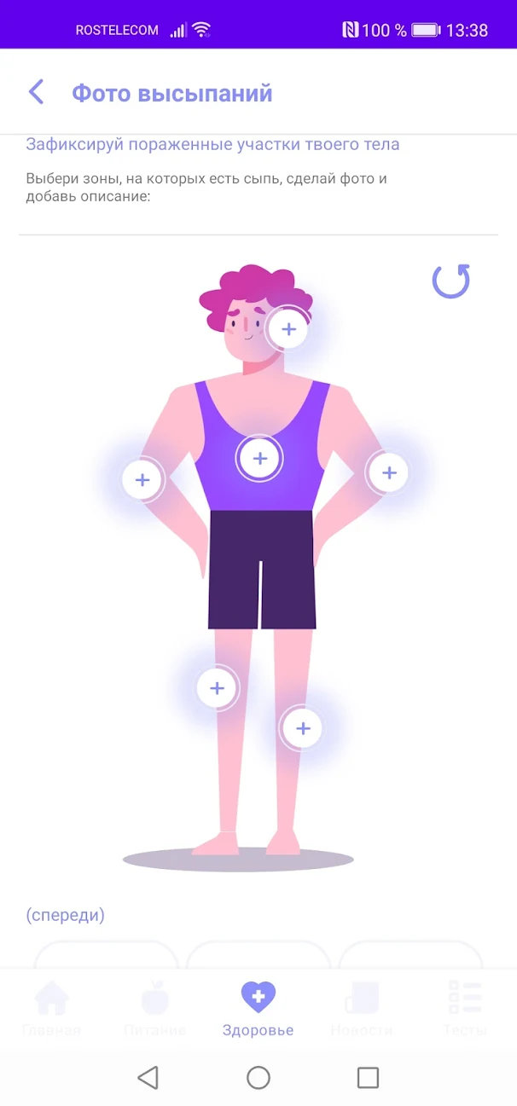

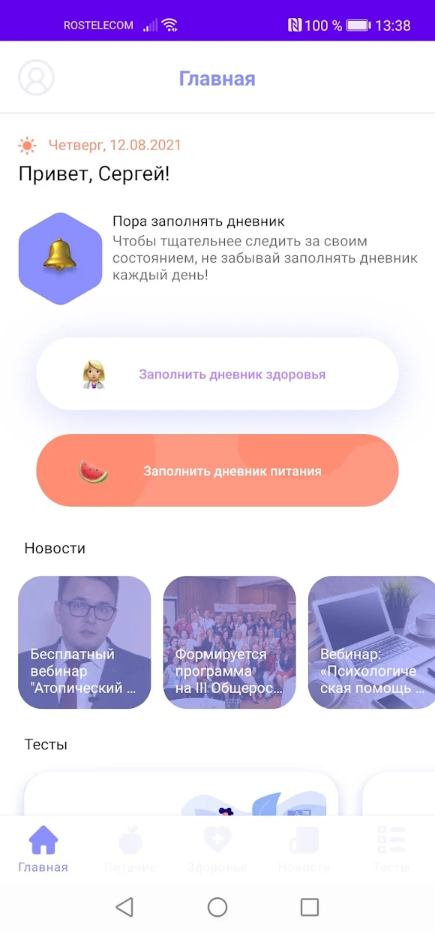
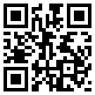
Mobile app update CheckSkin
Health diary
Food diary
Navigator of medical clinics
Self-control tests
CheckSkin App

Slide 3
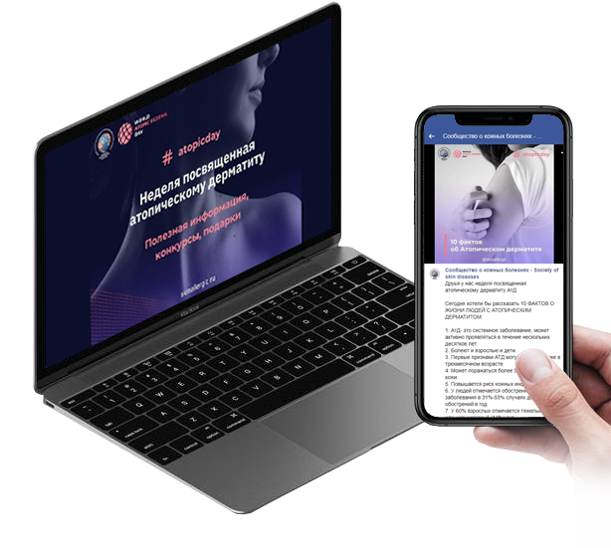
Marathon for psoriasis
reaching more than 60,000 people in social networks
active exchange of experience and advice of participants
increased awareness of their rights and new treatments

Slide 4
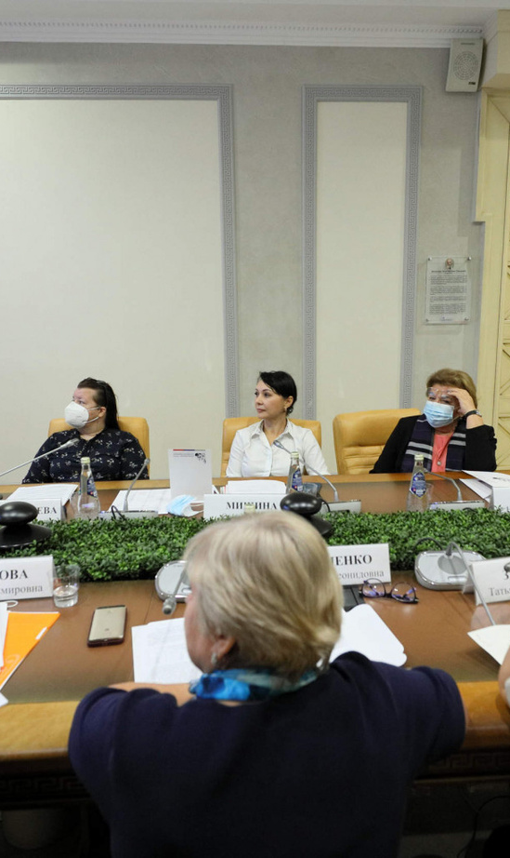
Round tables in the Public Chamber
and State Duma
A decision was made to establish a working group to revise the criteria for disability
Proposals were sent to the relevant departments to solve the problem of the availability of drugs from preferential categories

Slide 5

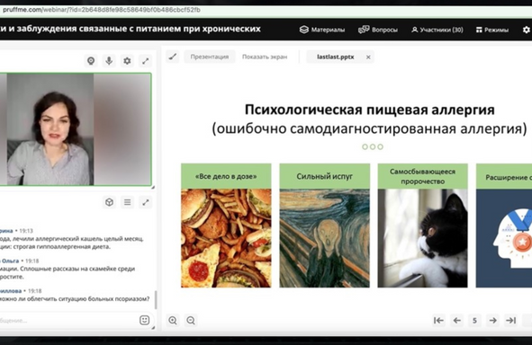
Project "Harmony in the soul - healthy skin"
Free psychologist consultations
11
Number of webinars :
Number of participants :
483

Slide 6
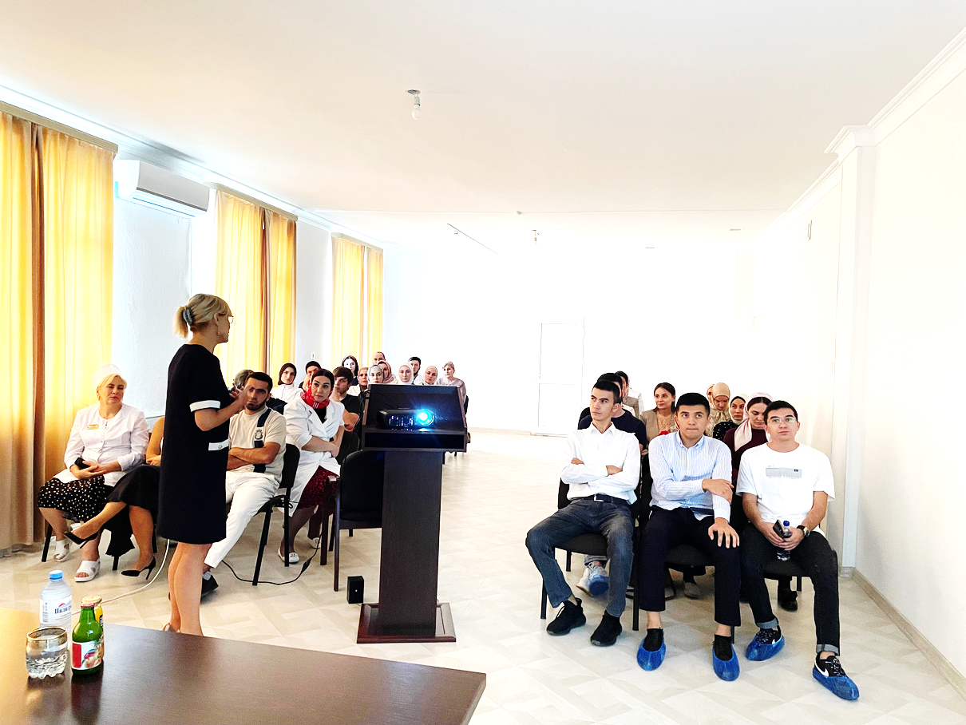
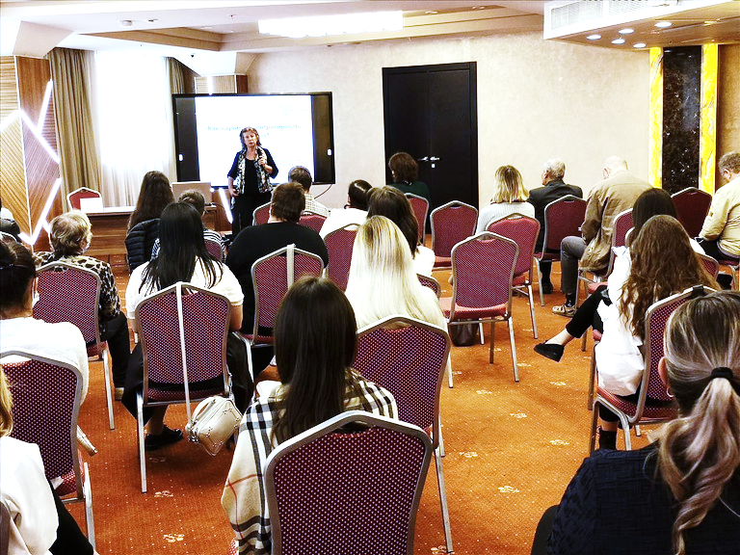
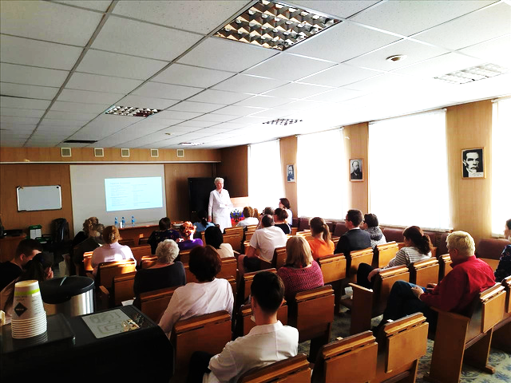
Traveling schools in Russia

Slide 7
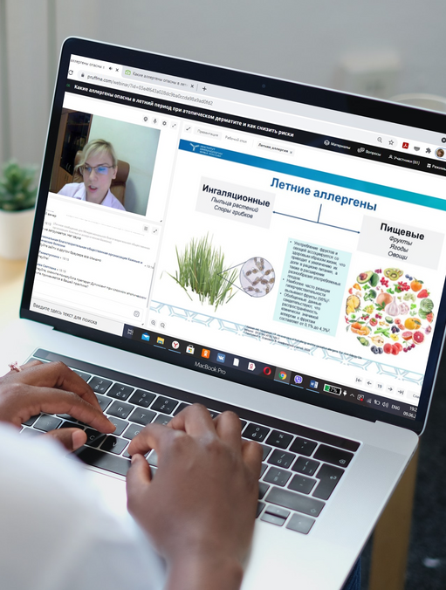
Webinars with experts
Dedicated to diseases of the skin and joints and the rights of patients
17
Number of webinars :
Number of participants :
724

Slide 8
 | - Совершенно не удовлетворен
 | - Скорее не удовлетворен
 | - В чем-то удовлетворен, в чем-то - нет
 | - Скорее удовлетворен
 | - Полностью удовлетворен
 | - Затрудняюсь ответить
 | - Не получал помощь по ОМС у дерматолога в этом год
Results of a survey on satisfaction with care in the profile
of dermatovenereology
%
?
X

Slide 9
In your opinion, has the quality and accessibility of community-based dermatological care changed in 2021? (post-pandemic)
Poll results
%
 | - Качество и доступность стали хуже
 | - Никак не изменилось
 | - Качество и доступность стали лучше
 | - Затрудняюсь ответить, не могу сказать
?

Slide 10

Brochure on disability criteria
Developed with expert input for patients with atopic dermatitis and psoriasis

Slide 11

III All-Russian Forum for the Protection of the Rights and Interests of Patients with Chronic Skin Diseases and Allergic Conditions
The forum covered 1078 participants from almost all regions of Russia.
The issues of drug supply and accessibility of medical care, disability criteria and modern methods of treatment in dermatology were covered.
More than 4,000 views of individual speeches of speakers posted on the resources of the organization.

Slide 12
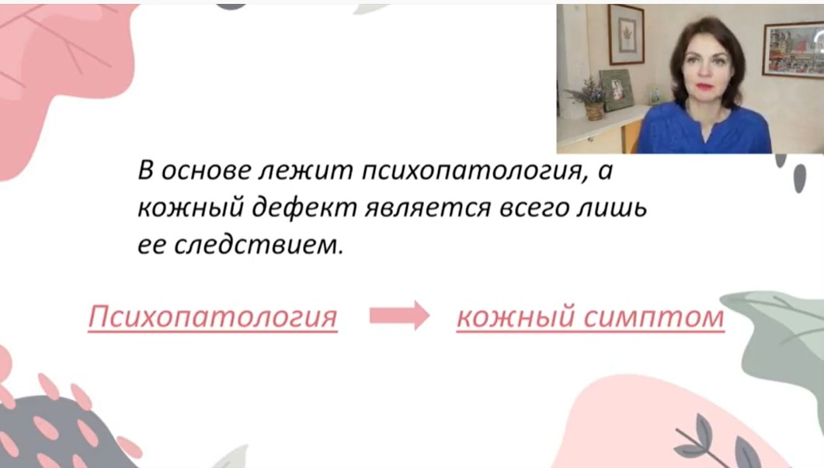
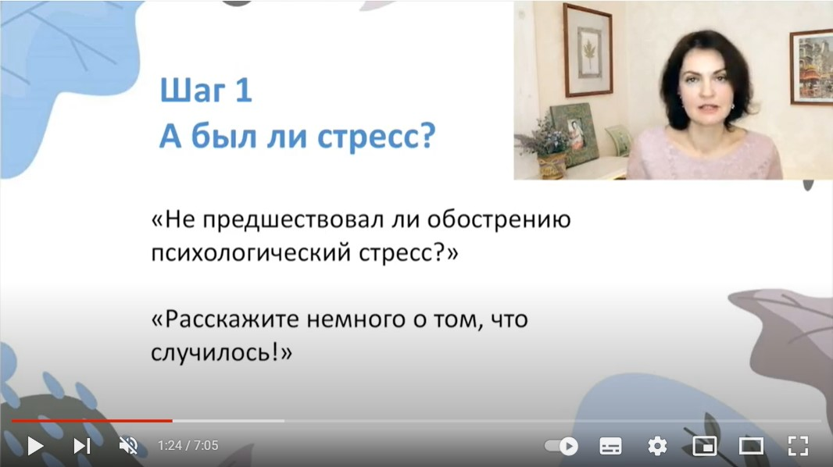
Video-Rollers for doctors
Primary mental disorders in dermatology.
Help of a dermatologist for psychodermatological patients.

Slide 13
Join our community!
B
CHECKSKIN
C
КОЖА-АЛЛЕРГИЯ.РФ
D
НАВИГАТОР ДОСТУПНОСТИ
O
ПСОРИАЗРЕГИОН.РФ
Q
OPPSOR@YANDEX.RU
X
ВКОНТАКТЕ
OUR RESOURCES

