Slide 1

World Psoriasis Day 2021 Activities
- Japan -
30 September 2021

Slide 2
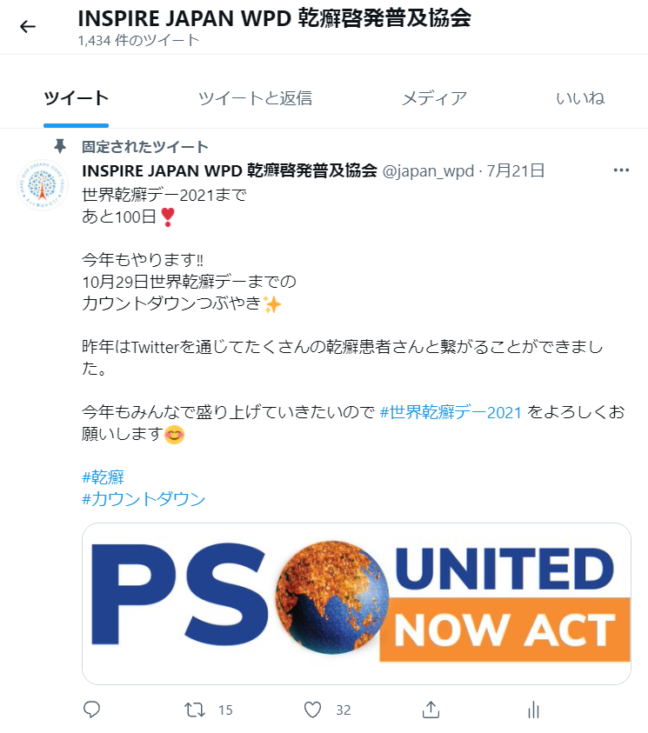

Summary
Countdown to WPD2021
Major activities toward/around World Psoriasis Day 2021
Countdown to WPD2021 on the social media
Online discussion on miscommunication between patients and physicians (pre-recorded)
Psoriasis Exhibition 2021 in Tokyo Tower
Event T-shirt for “unity”
Events for WPD2021

Slide 3


Countdown to WPD2021 on social media
Aiming to warm up WPD 2021
Started 100 days before WPD 2021 (October 29)
Daily tweet & post on psoriasis/world psoriasis day on our official account of Twitter and Facebook with hashtags
More than 8,000 impressions depending on the day so far

Slide 4
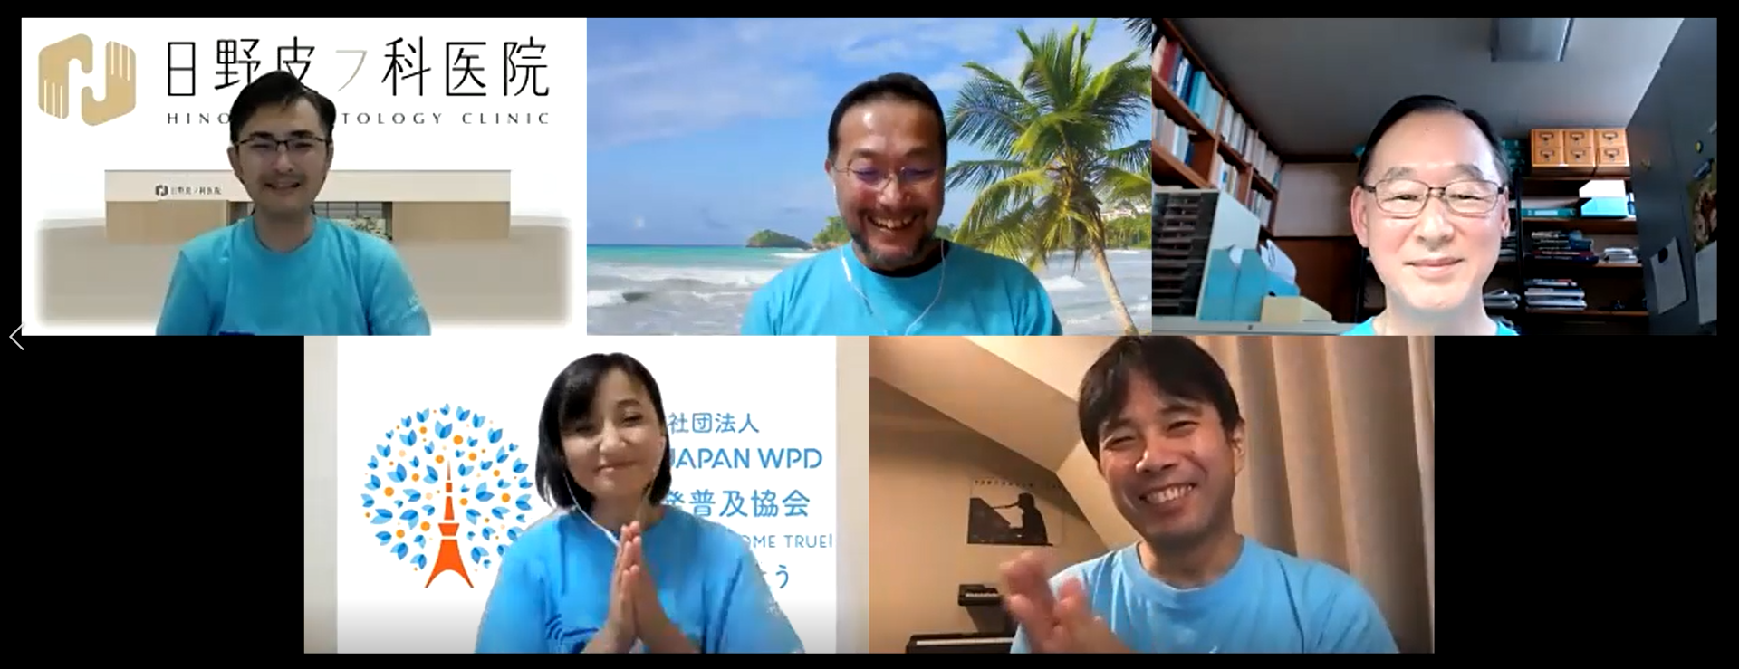
Online discussion on miscommunication
Aiming to provide patients tips for better communication with physicians
Discussing why miscommunicating between patients and physicians with inviting a dermatologist
Focusing on not miscommunication itself but issues behind it
The pre-recorded video will be released on our YouTube channel on October 29
Snap of last year’s online discussion

Slide 5
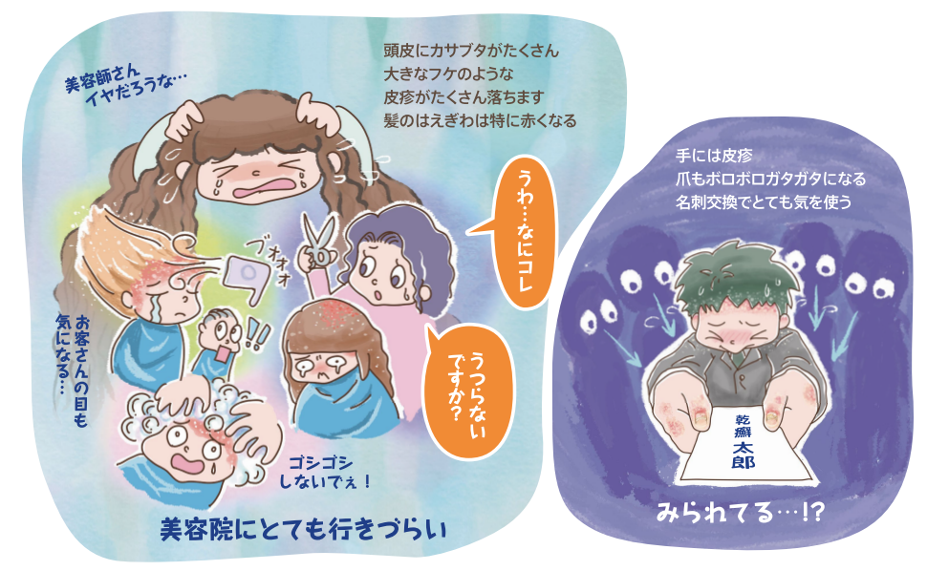
Psoriasis exhibition 2021 in Tokyo Tower
Aiming to raise awareness of psoriasis
Exhibiting posters on psoriasis with cartoons
Giving a small gift to guests with a message of “Psoriasis is not contagious”
The exhibition will be open from October 30 until 31 in Tokyo Tower.
Samples of last year’s cartoons
Hard to go to hair salon/barber
Ashamed when exchanging
business cards

Slide 6
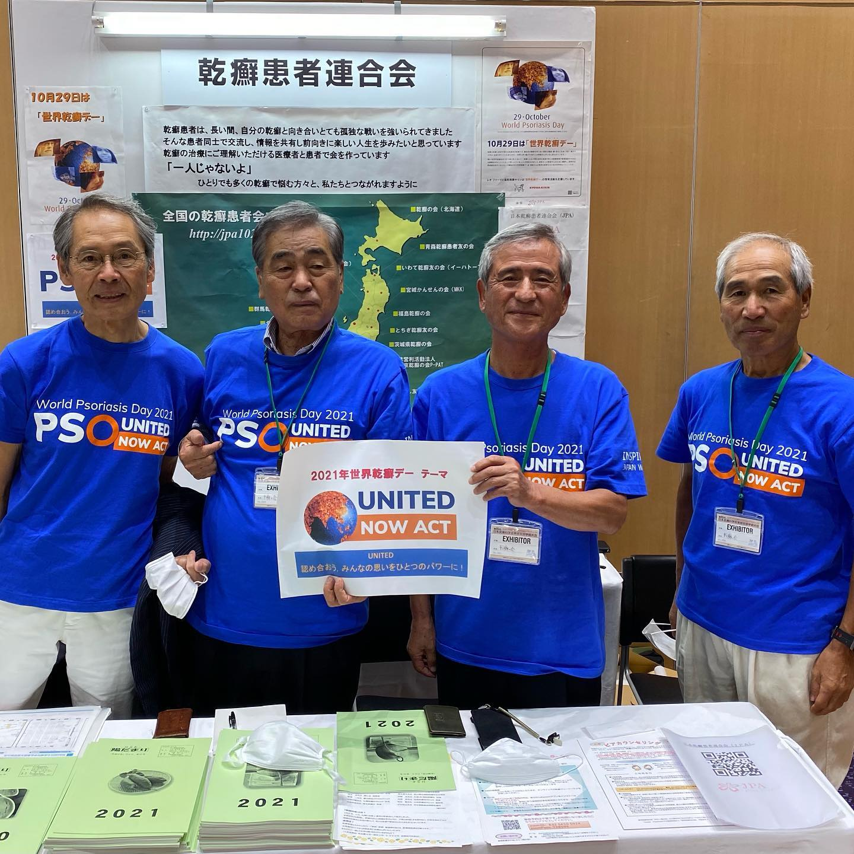
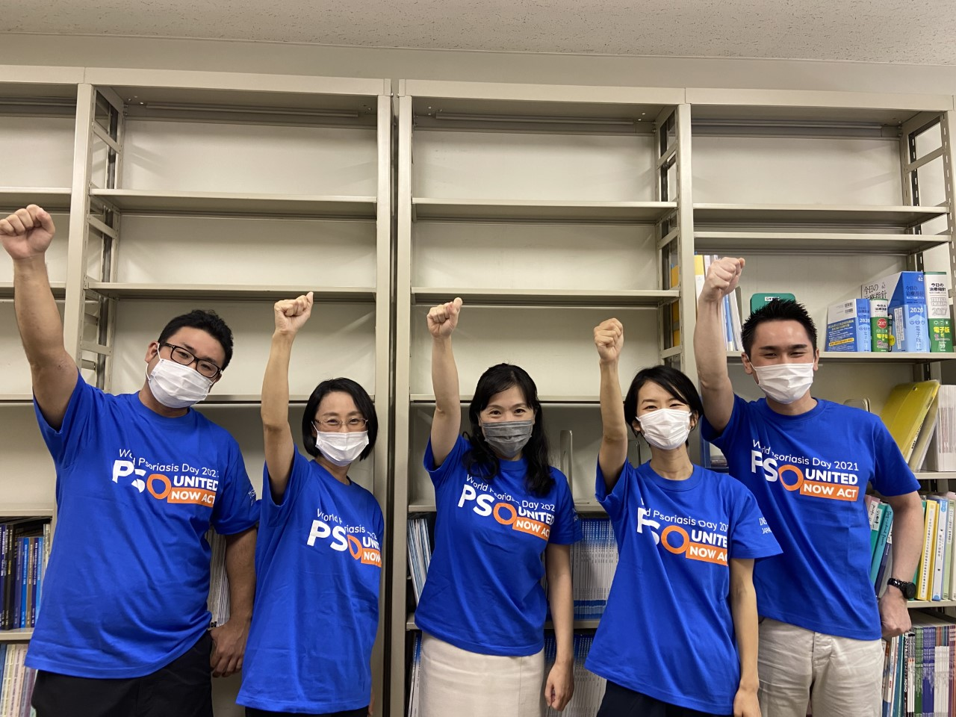
Event T-shirt for “unity”
Aiming to promote WPD2021 as well as to unite people
United many patients, dermatologists, and corporate partners with the T-shirt
Psoriasis Association in Hokkaido
Department of Dermatology, Yokohama City University

Slide 7
Thank you for your kind attention!

