Slide 1


Slide 2
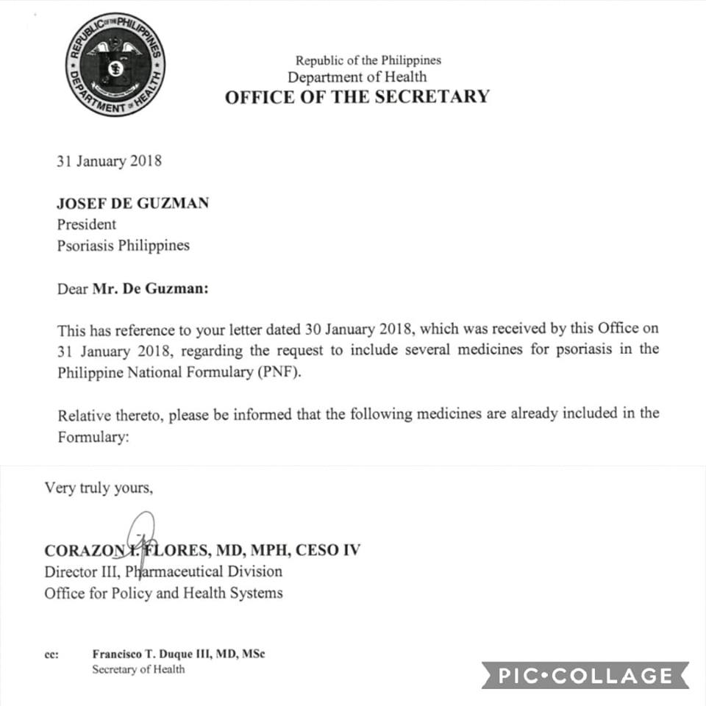
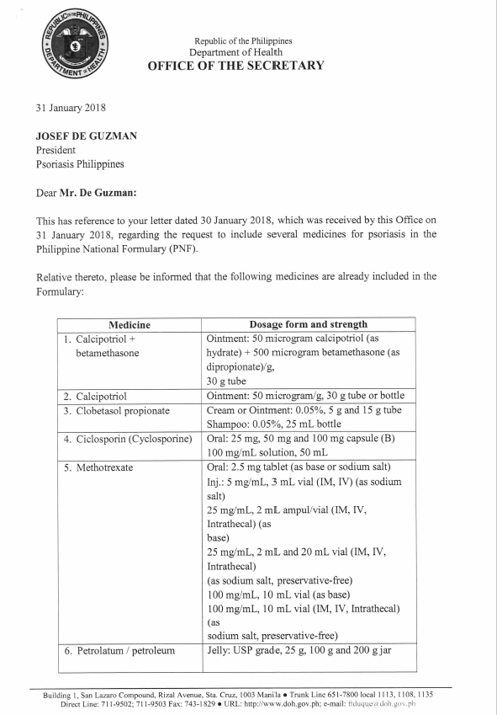
Philippine National
Formulary
14 medicines for Psoriasis
is NOW included in the formulary.
Government can now purchase this medicines for:
Public Hospitals
City Health Office
Regional Health Units

Slide 3

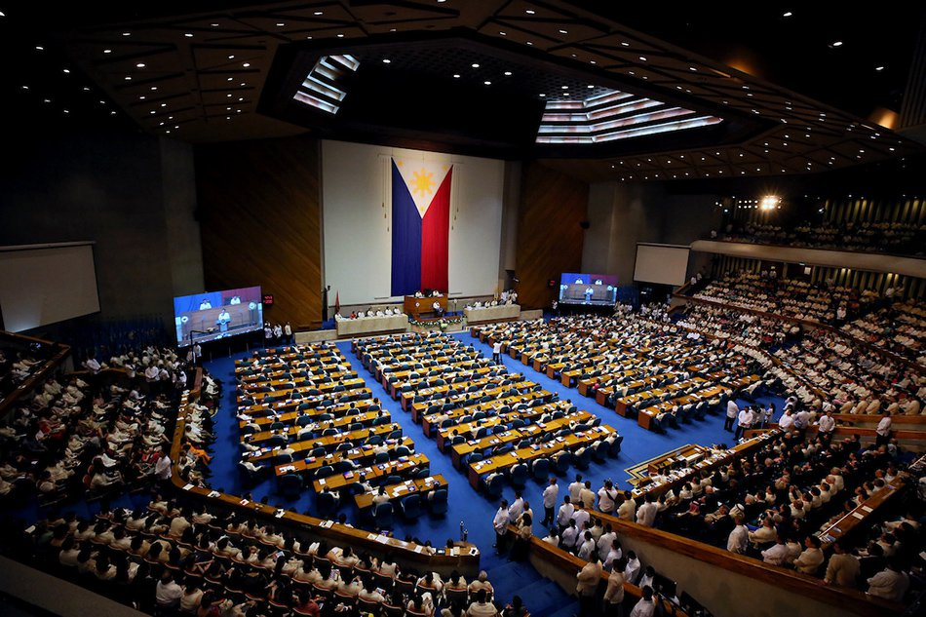
Policy & Advocacy Work
National Psoriasis Care Act
House Resolution 9821

Slide 4

Multi Stakeholders Meeting
27 October 2021
Tentative date: Preparation: September
Invitation: October w1

Slide 5

WWP with Cong. Helen Tan
October 29, 2021
An episode of Weekends with Psorphil will be dedicated to the psoriasis Bill with Cong. Angeline Helen Tan as guest

Slide 6


Slide 8
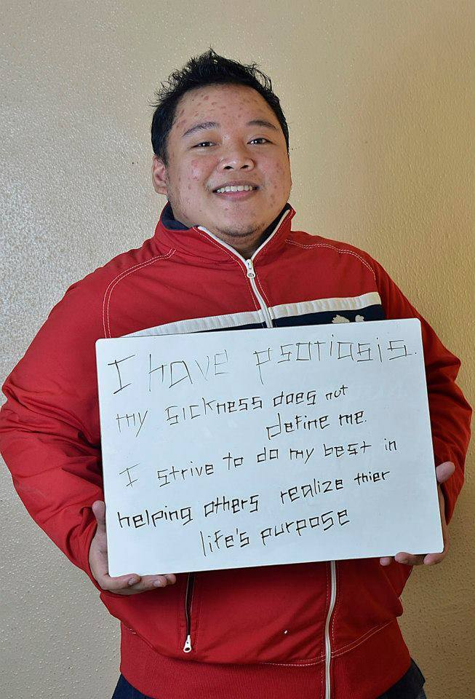
Social Media Campaign
Celebrities / Media Influencers
Doctors
Patient Organizations
Civil Society Organizations
Disability Sector
Schools
Private Sector
I support
#PsoriasisBill
NowNa

Slide 9

Twitter Party
#PsoriasisBillNowNa
#FreedomFor2M

Slide 10

Tik-tok Dance Challenge
Launch: 01 October 2021

Slide 11



KUMU Concert Livestream

Slide 12
Information drive on Proper medication
Featuring: Psorphia

Slide 13

Multi-Sectoral Engagements
DOH Seminar: Psoriasis as NCD
Kutis Kilatis (Psoriasis Screening)

Slide 14

Caravan Of Hope
November 2021

Slide 15
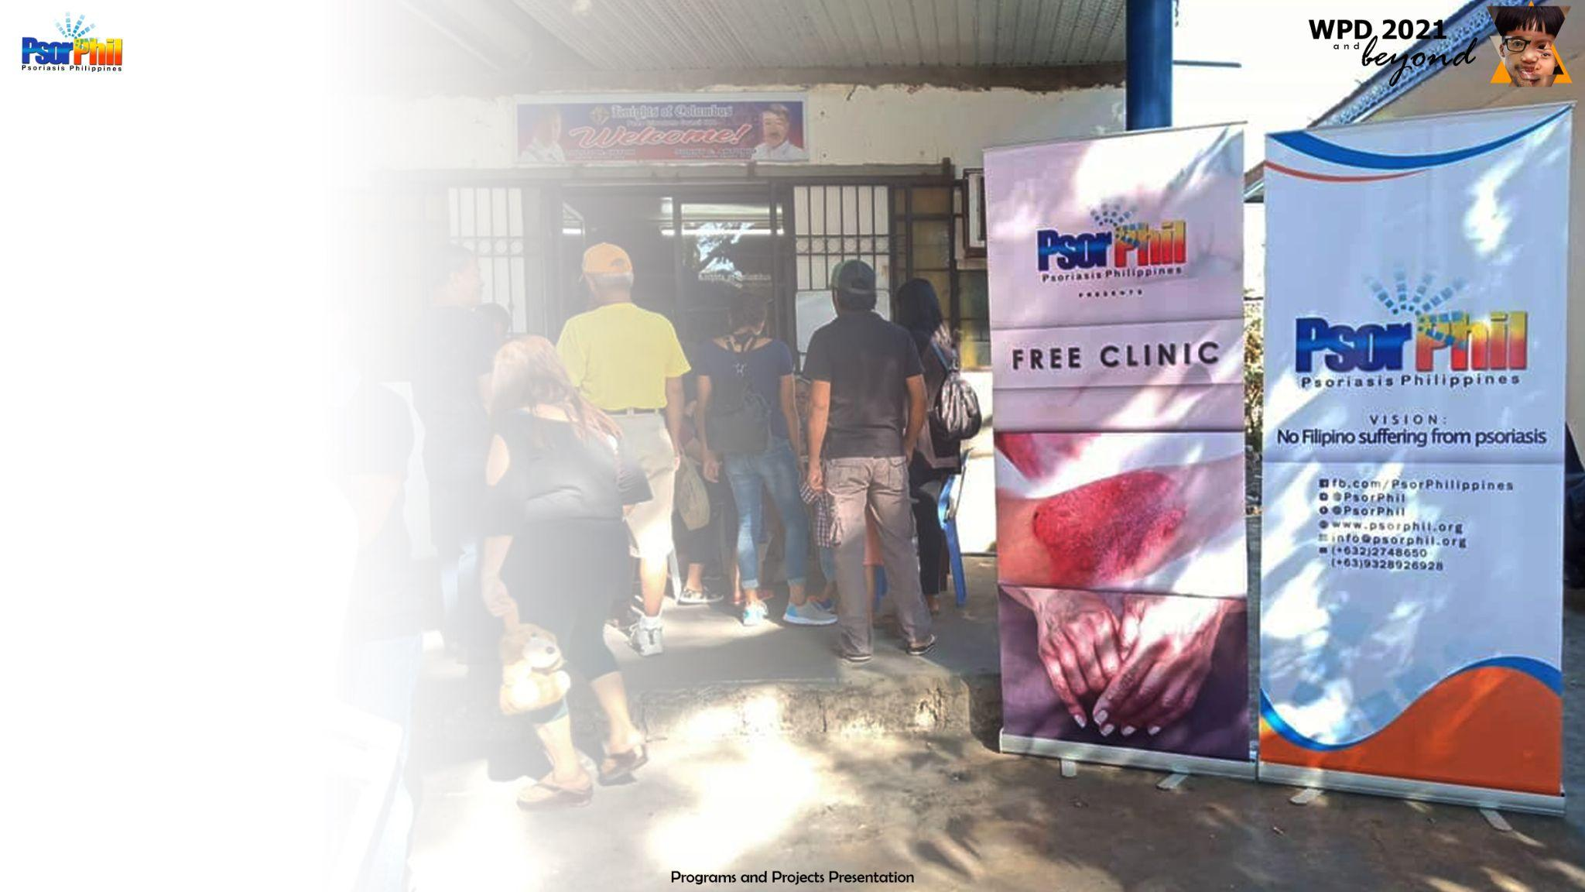
Skin and Bone Clinic
25-29 October, 2021

Slide 16
Patient Education & Empowerment

Slide 17
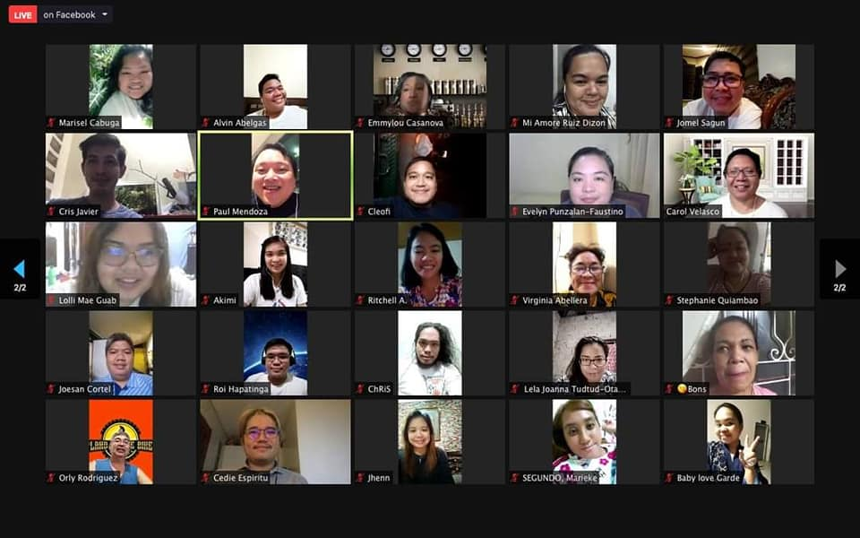
Patients Summit: Psoriasis 101
08 October 2021

Slide 18

BMW
November 2021- W2

Slide 19

Youth Summit on NCD
November 2021- W1

Slide 20
Let’s Get United:
The Philippines WPD Celebrations

Slide 21
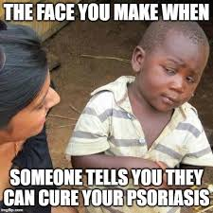
Hugot Lines
Launch: September W2

Slide 22

Tag Line Contest

Slide 23

Psorphil Got Talent
29 October 2021

